Slide 1
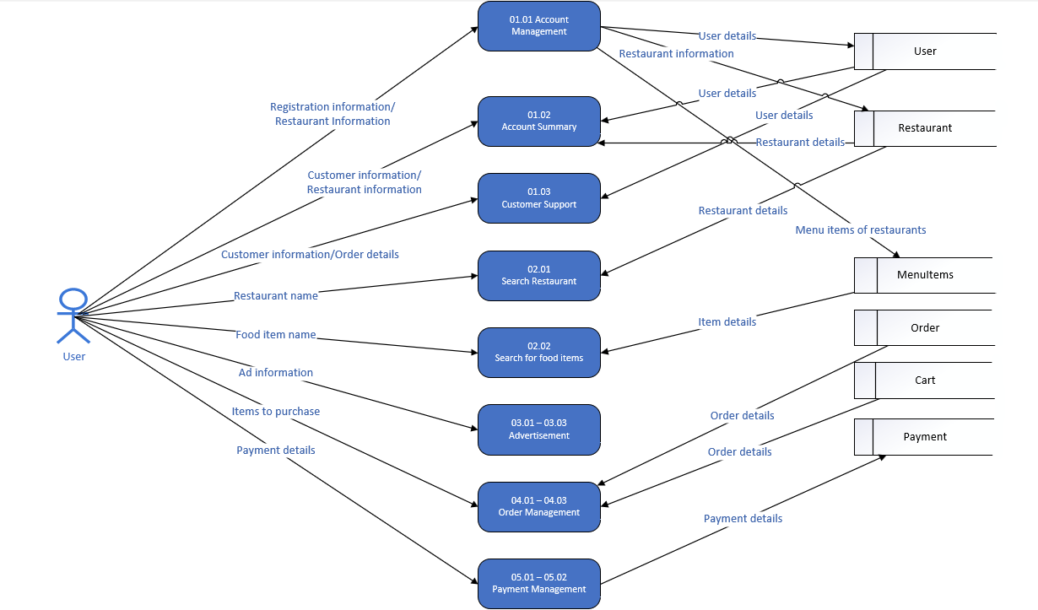
NutraMeals
Data Flow Diagram (Physical)

